Slide 1
Jermyn Borough Council Meeting
08/01/19

Slide 2
Meeting Agenda
Call to Order
Pledge of Allegiance
Roll Call
Previous Meeting Minutes
Treasurer’s Report/Bills Payable
Correspondence
Public Comment
2020 Census Presentation
Insurance Presentation
Reports
Reports of Committees
Borough Flag
Ban from Borough Property
Alternate Parking Ordinance #3-2014
Woodlands Sewer Grant
Executive Session – Personnel
New Business
Adjournment

Slide 3
Treasurer’s Report

Slide 4
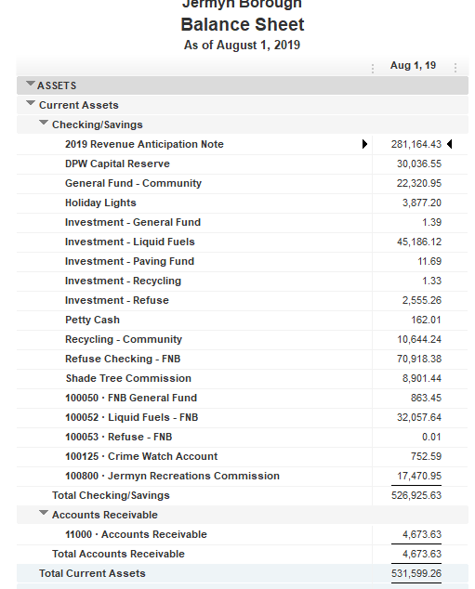

Slide 5
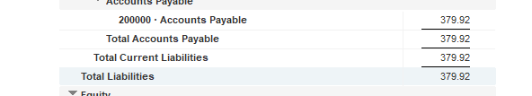

Slide 6


Slide 7


Slide 9


Slide 12
MS4 Program Update
MS4 is a mandate administered by the DEP.
The MS4 program requires the MS4 owner/operator to implement a series of programs to reduce the discharge of pollutants from the storm sewer system to the maximum extent practicable in a manner that protects water quality.
Requirement is to reduce sediment pollution by 10%, phosphorous by 5% and nitrogen by 3% by 2023.
Until recently, not much attention was paid to the program because of the large administrative burden and cost associated with all of the requirements. Regulations were mainly unenforced. KBA was managing the Permits and mapping for the borough, and continues to do so.
Since the implementation of the MS4 committee, we have begun developing the required documentation and programs to comply with the requirements, but we are far from implementing real programs that will result in the required pollutant reduction. These programs, such as street sweeping, creating catch basins, installing rain gardens, flood mitigation projects, and implementing other pollution prevention programs will be costly and will place a heavy burden on the borough. We will continue applying for grants and implementing low cost items to sustain the program for as long as possible.

Slide 13
In May of 2019, Senator Blake’s office held an informational session on the possibility of organizing a regional approach to the management of MS4. Mayor Fuga, Dan Markey and Kristen Dougherty attended the session. The benefits and downfalls of a County-Wide Stormwater Management Authority were discussed.
It was noted during the session that if this was to move forward, the fee would be assessed County-wide, regardless of if the municipality wished to participate in the program. As a result of that statement, Jermyn will consider all options as more information becomes available. If the fee will be paid by all residents, then we should benefit from having to pay it.
The following information was given as to the next steps:
Create a Task Force to determine the needs of local government
Define the financial, administrative, environmental and other benefits of a regional authority
Hold public meetings
Perform a feasibility study
Hold another workshop
If it is decided to move forward, a public hearing will be held on the proposal.
The county commissioners will need to enact an ordinance to authorize the creation of the authority
Advisory committees will be established to recommend board members for the commissioners to appoint.
If all of the above items happen, the timeline from the creation of the authority to implementation will be about a 2 year process.
Since the meeting in May, we have received no updates on any of the next steps listed above.

Slide 14
